Slide 1


WELCOME TO THE 19TH ANNUAL VIRTUAL NPIEN EDUCATION CONFERENCE
Notes:
Victor: Announce David
David - We Welcome you to the 19th Annual and 1st time virtual NPIEN Education Conference on Zoom and Facebook Live

Slide 2
WELCOME TO THE 19TH ANNUAL VIRTUAL NPIEN EDUCATION CONFERENCE
Notes:
Victor: Announce David
David - We Welcome you to the 19th Annual and 1st time virtual NPIEN Education Conference on Zoom and Facebook Live

Slide 3

Master of Cerermonies:
David Brown, Mylay from Island Mix Radio and Niu Radio “Good Island Music”
106.3 FM
Notes:
David: I am David Brown your Master of Ceremonies. A reminder to all in the Zoom Conference to mute yourself unless you are called on to speak. Virtual hand waving is how we applaud.

Slide 4
NPIEN Board Members and Staff Members
President: Tino Andres
President-Elect: Will Safotu
Vice President: Ethan Nguyen
Immediate Past President: Teresa Molina
Secretary: D. Kalani Heinz
Treasurer: Sean Munley
Directors:, Cliff Kusaba, Mark Kailiponi, Seiuli Fa’auliulito H. Meni, Angel Mikaele, Hector Molina, Past President, Tiloi Tuitama, Channel Coast Chapter President, Charmaine Tuilefano, Inland Empire Chapter President, Jonathan Tovey, Midwest Chapter President, Anjani Varma, Northern California Chapter President
Alternate Directors: Leatapo Fesili, Inland Empire Chapter Liaison, Lupe Moe, Midwest Chapter Liaison
STAFF
Executive Director: Dr. Victor C. Thompson
Executive Assistant: Caroline Sereno
Staff: Lauren Bowman, Loriann Leota, Nona Palmer, Sharma Uma, Emma Kailiponi, Intern, Esther Kailiponi, Intern
Notes:
David: I would like to recognize the NPIEN Board Members and Staff Members who have worked to provide this conference for you. Please welcome Tino Andres, NPIEN President

Slide 5
Special Thanks to the
Participating Colleges:
Cerritos College
Cal State University, Long Beach
California State University, Los Angeles
Long Beach City College
Los Angeles Harbor College
Los Angeles Trade Tech College
Loyola Marymount University
Rutgers University
San Jose State University
University of California, Irvine
University of Hawai’i Manoa
Notes:
Tino: Thank you David and welcome to everyone. We hope you enjoyed our first virtual college fair. Please join me in thanking each of our institutions (read all names). A special thanks to Ema Thompson of Rutgers University for your support. The college fair will continue after this ceremony has concluded for another 30 minutes. Please welcome Teresa Molina, NPIEN Past President

Slide 6
Special Thanks to our
Major Sponsors:
California Credit Union
Dr. Siona Motufau Jr., DDS
Henry Chang, CPA
NT & Associates
Lagniappe Accounting, Inc.
AJC Plumbing
Pro Printing
Association of California School Administrators
Notes:
Teresa: Thanks to all of our Major Sponsors for your generosity in a difficult economic time. Their donations paid for the awards, lunch gift cards, and raffle prizes and mailing the awards to you.

Slide 7
Special Thanks to our
Awards Sponsors:
Senator Hannah Beth Jackson
Senator John Moorlach
Assemblymember Marie Waldron
Assemblymember Tasha Boerner Horvath
Ventury County Supervisor, Kelly Long
San Diego County Supervisor, Jim Desmond
Carson City Council
Amy’s Trophies
Notes:
Teresa: Thanks to each of the Assemblymembers, Senators, County Superintendents, and School Boards for donating the certificates

Slide 8
Awards Sponsors:
Oceanside Unified School District – El Camino High School, San Marcos City Council, Mayor Eileen Weir, City of Independence, Missouri, Superintendent Dr. Darin Brawley, Compton Unified School District, Mayor Peggy Lemons and Paramount City Council, Oxnard Union High School District Board of Trustees, Long Beach City Councilmember Rex Richardson, Paramount Unified School District Board of Education, Assemblymember Mike Gipson
Notes:
Teresa: (Do not read, pause to have the audience review) Please welcome NPIEN President Elect Will Safotu

Slide 9
Special Thanks to our
Scholarship Sponsors:
Dr. Siona Motufau, Jr., D.D.S.
Henry Chang, CPA
Ross for Less
Melaleuca
Cliff Kusaba
Teresa and Hector Molina
Dr. Victor and Marie Thompson
Mark McKeon
California Teachers Association Pacific Asian Caucus
Teachers Association of Long Beach
Pete’s Plumbing
Ray Vincent
Cerritos College Trustee Marisa Perez
Frank Boehler
Bruce Lee
Pasifica Financial Corporation
Notes:
Will: : Thanks to our generous scholarship sponsors which allowed us to provide 14 scholarships today. A special thanks to Dr. Motufau and Henry Chang (Do not read the rest)

Slide 10

Entertainment:
Thanks to Director, Healani Barbee - Director and Dancers
Tahitian Number:
Tanner Quinto
Michelle Mitchell
Healani Barbee
Tongan Number:
Finau Makaafi
Moli Makaafi
Healani Barbee
Notes:
David: Healani Barbee is a former Christina Diaz scholar and Director of Pure Polynesia. They will first perform a dance from the Island of Tahiti, Ia Ora na!

Slide 11

Entertainment:
Tahitian Dancers:
Tanner Quinto
Michelle Mitchell
Healani Barbee
Pure Polynesia
Healani Barbee, Director
Former Christina Diaz Scholar
Notes:
Staff: Start Video

Slide 12
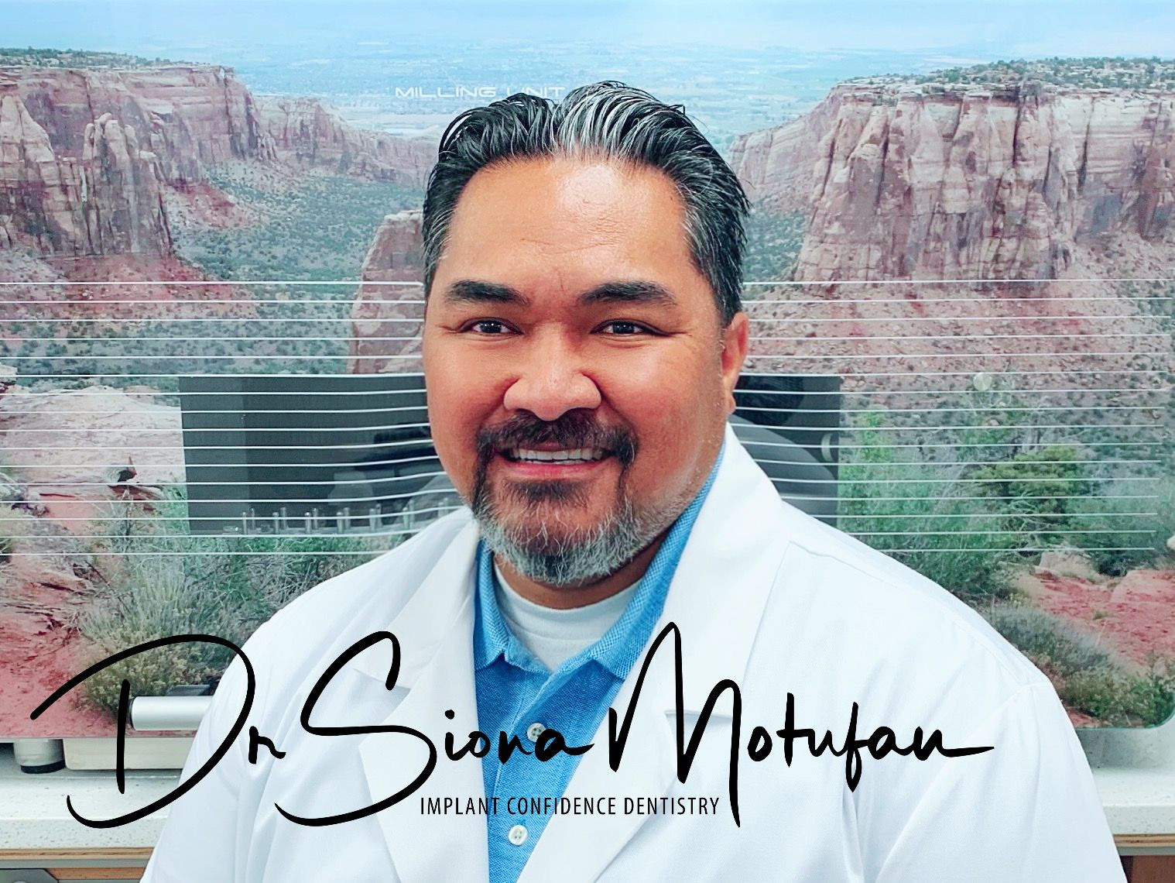
Keynote Speaker:
Siona Motufau, Jr., D.D.S., D.I.C.O.I., F.A.A.I.P.
Dr. Motufau began his dental education in 2007 when he received his Bachelor of Science degree in Biology from the University of California State, San Bernardino. From there, he went on to receive his Doctor of Dental Science degree from the Herman Ostrow School of Dentistry of USC.
Notes:
Will: I would like to present Dr. Siona Motufau, our keynote speaker. Dr. Motufau was born in American Samoa, and raised in Southern California with 10 siblings, and is the first in his family to graduate from college, He speaks fluent Spanish, having served a two year church mission in Panama. While at USC’s School of Dentistry, he served a the USC Minority Outreach Ambassador, in charge of setting up pipelines for surrounding underrepresented communities to pursue careers in the medical fields. He has two dental practices which focus on Dental Implant Surgeries and Fix and Removable prosthetics. Dr. Motufau’s dedication to advance training and hard work in his field has helped him produce in the top 1% of his field. Dr Motufau currently lives in Grand Junction, Colorado with his beautiful wife Stephanie and 3 busy boys, (Ara,Mack,and Julian). Please welcome Dr. Siona Motufau.
(Thanks Dr. Mtufau for his remarks and his support of NPIEN’s Scholarship Awards)
Please welcome NPIEN Vice President Ethan Nguyen.

Slide 13
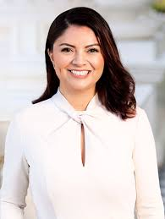
Speaker:
Ernesto Castillo,
District Representative of Senator Lena A. Gonzalez
Senator Lena A. Gonzalez was elected to the State Senate to represent the 33rd District in June of 2019.
Notes:
Ethan: Ernesto Castillo is the District Representative for Senator Lena A. Gonzalez (Introduce the Senator) Ernesto will now provide remarks. (At end of remarks): Thank you Ernesto

Slide 14
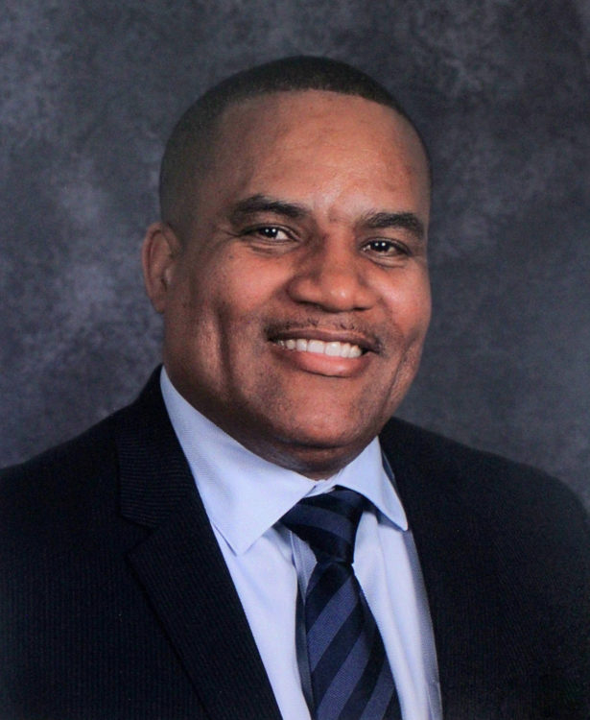
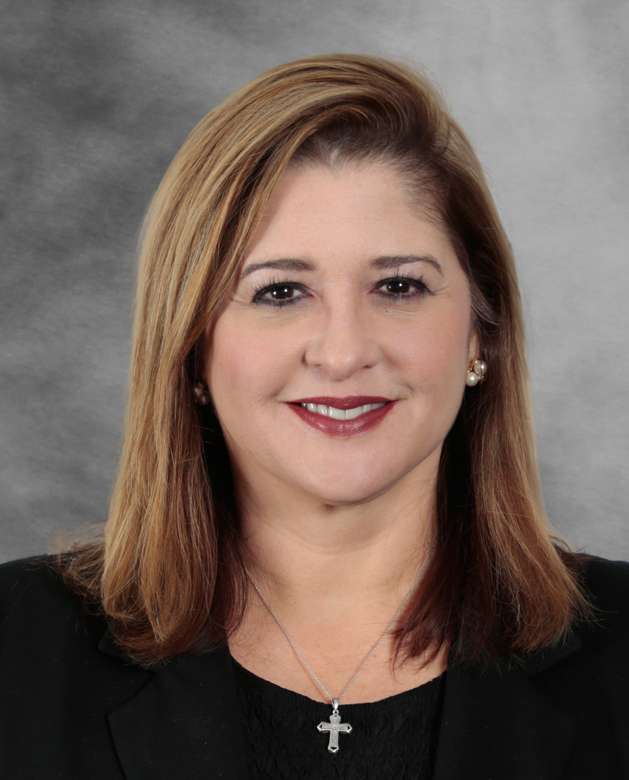
Guest Speakers
Dr. Darin Brawley, Superintendent - Compton Unified School District
Dr. Ruth Perez, Superintendent - Paramount Unified School District
Notes:
Ethan: We would like to introduce Dr. Darin Brawley, Superintendent, Compton Unified School District and invite him to share his remarks. The NPIEN Conference was held for several years at Davis Middle School and our mentoring program has been hosted at Davis, Dominguez High School, Compton High School; Kennedy Elementary School, Roosevelt Middle School; and Willowbrook Middle School.(End of remarks) Thank you Dr. Brawley.
Dr. Ruth Perez, Superintendent, Paramount Unified School District will now address us. The NPIEN Conference has been held four times at Paramount High School, and our mentoring program hosted at Paramount High School West Campus, Paramount High School, Lakewood Elementary School, Buena Vista High School, Paramount Park Middle School.(At end of remarks) Thank you Dr Perez.

Slide 15
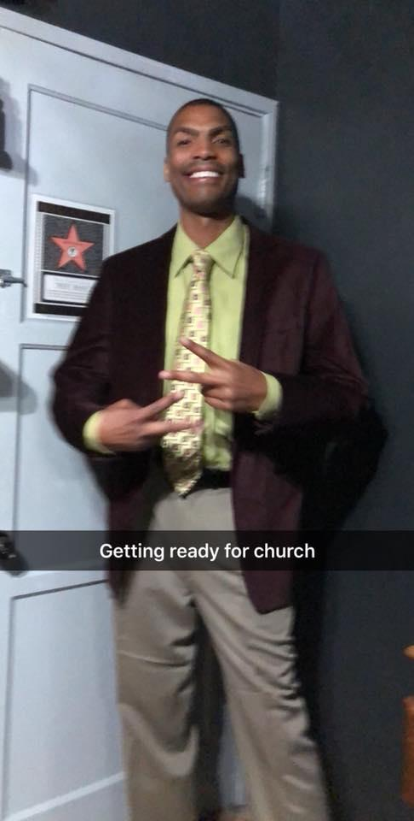
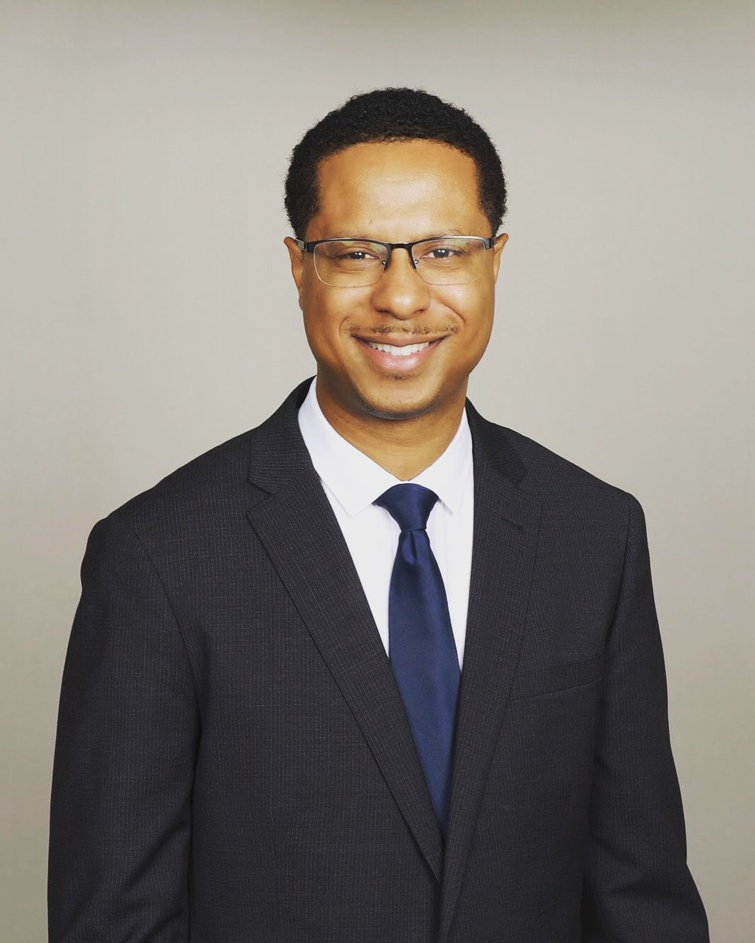
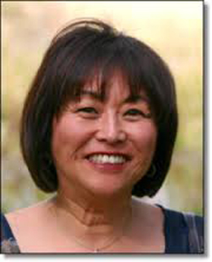
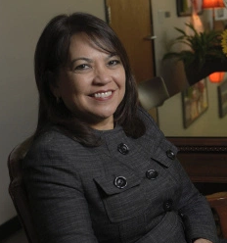
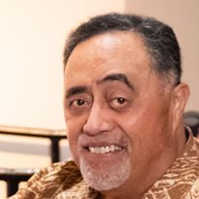
NPIEN Recognition Awards
Dr. Alofa Tanuvasa Community Award, Rodney Andrews
Sevia Ma’ae Educator Award, Ian Eddy
Retirement Award, Aileen Tanimoto Matsuura, Past President of NPIEN, Paramount HS Teacher
Retirement Award, Ruth Perez Ashley, Honorary NPIEN Board Member, Deputy Superintendent, Long Beach Unified School District
Honorary NPIEN Board Member, Posthumous, Sai Momoli
Notes:
Tino: We would like to recognize the following individuals, please wave and be recognized (Note: We were not planning on any speeches due to time, but consider one for Jackie Momoli if she indicates she would like to)
Tino: Rodney Andrews is the recipient of the Dr. Alofa Tanuvasa Community Award for his service to the Pacific Islander Community. The late Dr. Tanuvasa is a former Compton USD teacher who devoted much of his time to serving the community. Mr. Andrews gives much of his free time to the Compton community to make it a better place for its citizens, and volunteered to mentor Pacific Islander students at Davis Middle School and Dominguez High School. Mr. Rodney Andrews.
Tino: Ian Eddy is the recipient of the Sevia Ma’ae Educator award, named after the late Sevia Ma’ae, a former teacher in the Lynwood Unified School District in Gifted and Talented Education. Mr. Eddy worked for ten years at Dominguez High School, volunteered to mentor Pacific Islander students about the importance of education. He also supported the Cultural Club at the school and work with Asian, Pacific Islander, Hispanic and African American students.Mr. Ian Eddy.
Teresa: Aileen Tanimoto Matsuura, recently retired as a Teacher at Paramount High School. She was honored for being a club advisor for 40 years at Paramount in 2019, and is the longest-serving Family, Career, and Community Leaders of America Club advisor in California. She is also the Past President of NPIEN. Congratulations!
Will: Ruth Perez Ashley recently retired as Deputy Superintendent, Education Services in the Long Beach Unified School District. Ruth is an Honorary NPIEN Board Member and has been a mentor to many Pacific Islander students. Congratulations!
Tino: Sai Momoli was the founder of the Pacific American Student Services organization (PASS) that supported the Pacific Islander Community in Carson. Sai always would reach out to NPIEN and we were able to support many of his student initiatives, including the PASS Golf Tournament which raised funds for student scholarships. The NPIEN Board has named Sai an Honorary NPIEN Board Member, and we our love and sympathy to Jackie Momoli and their family.

Slide 16
Pure Polynesia - Part II:
Pure Polynesia
Healani Barbee, Director
Former Christina Diaz Scholar
Tongan Dancers:
Finau Makaafi
Moli Makaafi
Healani Barbee
Notes:
David: Our Pure Polynesia Dancers will now present a dance from the Kingdom of Tonga! Malo e le lei!
Staff: Start video

Slide 17
Christina Diaz Scholars Awards
The late Christina Diaz was a Native Hawaiian woman who was one of the first NPIEN conference sponsors. Christina and her husband Ray supported our Scholarship Fund and were vendors at our early conference, with their business Ray’s Silvercrafts, Gourds and Christina’s Hawaiian Soaps
Notes:
David: We present the 19th Annual Awards Ceremony. Each of our students was nominated by teachers, counselor or community members. We will present each student, then ask them to wave and be recognized and share your Christina Diaz Medallion and certificates. Please applaud virtually. (David Reads each name then a Board Member takes over)

Slide 18
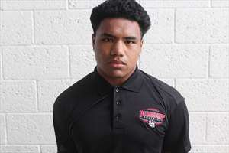
Christina Diaz Scholar Recipient
Place Photo Here
Jerry AhChing
Paramount High School Student
Notes:
David/Will: I am Will Safotu, NPIEN President Elect and Counselor, Long Beach USD: Jerry is a model student athlete. He is very conscientious and also inquire about ways to improve his writing and other sections of the course. He is also a phenomenal athlete and was often was awarded "player of the game" in a fantastic season that led to playing in a CIF Championship game. He is extremely polite and a pleasure to have in class and is outstanding young man. Jeffrey Beahn, Teacher

Slide 19

Christina Diaz Scholar Recipient
Place Photo Here
Ahnea Aupiu
Lindenwood University &
Academy of Education and Empowerment
Notes:
David/Teresa: I am Teresa Molina, NPIEN President and Business Owner, NT & Associates: Ahnea (ah-nay-ah) Aupiu (Au-pi-oo) is the Valedictorian for the Academy of Education and Empower Class of 2020, where she had straight As all four years. She is also a well-known athlete at Carson High School and is the Captain for the Spartans Rugby team. As the oldest girl of a Samoan family of six children, she is the caretaker of her younger siblings while her parents work to provide their daily necessities. Outside of the classroom, she can be found at her church and the community volunteering,, serving the less fortunate meals and helping collect clothes for those in need, plus she volunteered at Dolores Elementary, where she was able to utilize the skills she attained while caring for her younger siblings during her years volunteering at Dolores. Ahnea is a motivated, intelligent and a creative young woman who excels in all that she does. I am confident that as she will thrive in all that she does and will make the same powerful impressions at Lindenwood University in Missouri. Veiongo Naufahu, Counselor

Slide 20
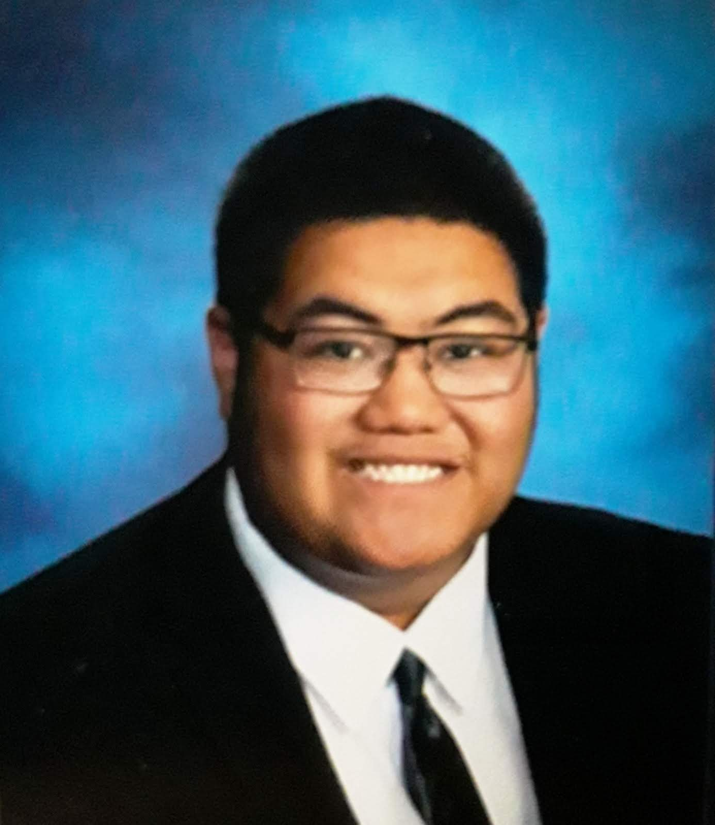
Christina Diaz Scholar Recipient
Place Photo Here
Kaisa Faleono
Jordan High School Graduate & Long Beach City College Student
Notes:
David/Ethan: I am Ethan Nguyen, NPIEN Vice President and (State your graduate work or profession): Kaisa has a 3.74 GPA, and has been a leader in Link Crew, welcoming incoming Freshman, and he served the new students with kindness. He is a Student Ambassador and represents Jordan High School and the community, talking to parents and community officials about the school, always in a professional manner, confident yet humble. Wendy Ili, Pathway Coordinator.

Slide 21
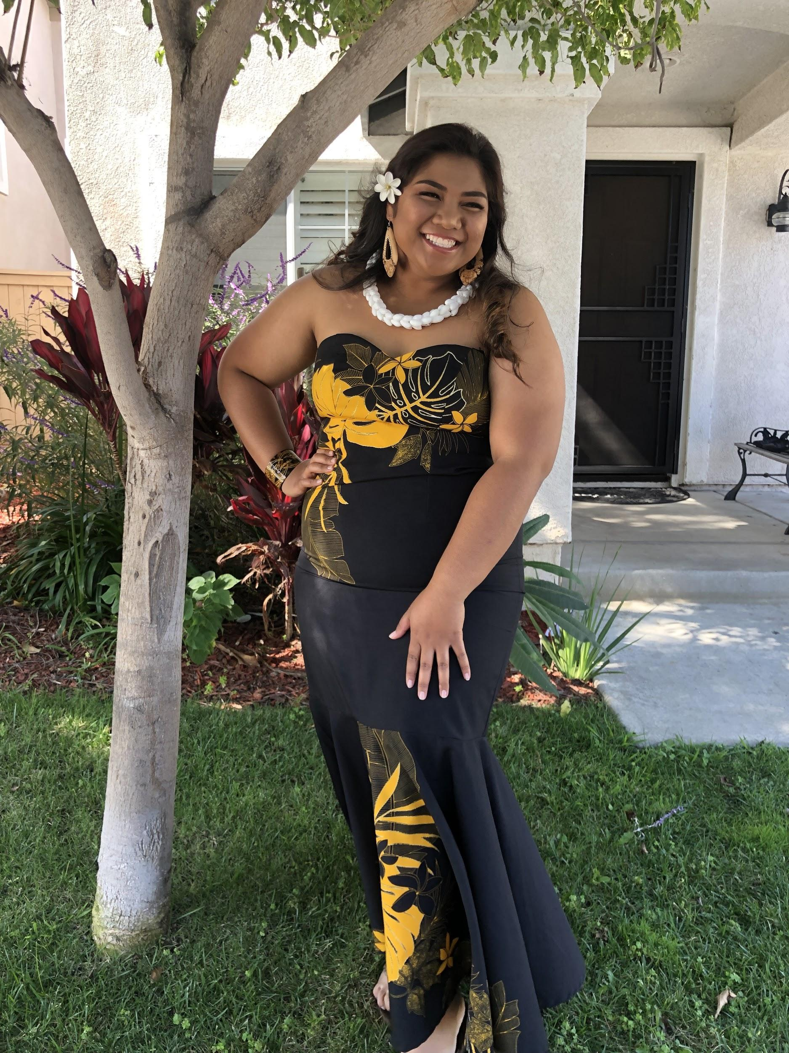
Christina Diaz Scholar Recipient
Place Photo Here
Taralina Paulo
El Camino High School
Notes:
David/Ethan: Taralina is a hard-working, kind spirited young lady. She strives to do her best and has managed to maintain a 2.86 GPA and kept a smile on her face in spite of having to overcome obstacles in her life. Taralina has been involved in AVID since the 7th grade, now as a graduating senior her eyes are looking towards the bright future and I'm positive she'll be able to attain it. Caitlin Degrafft, Counselor

Slide 22
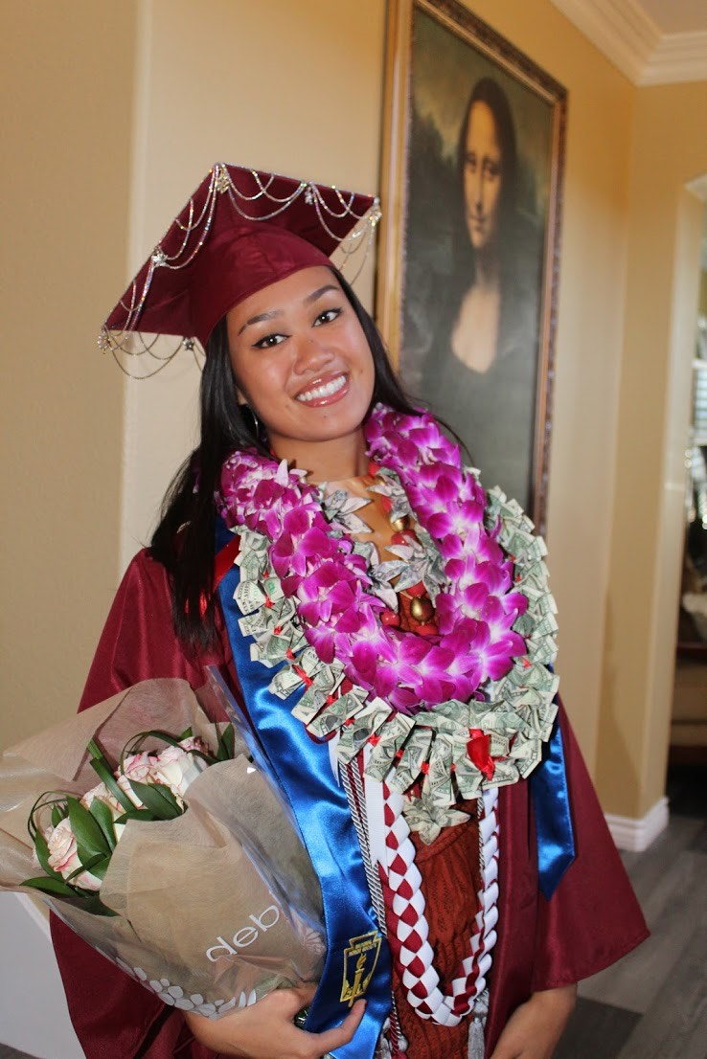
Christina Diaz Scholar Recipient
Place Photo Here
Charleen Pua
Mission Hills High School Graduate & UCSD Student
Notes:
David/Cliff: I am Cliff Kusaba, NPIEN Board Member and retired teacher, LBUSD: Charleen is a top senior in the AVID college readiness program at Mission Hills High School; she has participated in AVIDfor all four years of high school. She is brilliant and determined! She has earned nothing less than A throughout high school in her multiple Honors and AP courses; her GPA for her last three report cards was a 4.67. She is on our cheerleading team, an AP Ambassador, a board member for the UNICEF organization, and a San Marcos Youth Ambassador, which is a volunteer program for our city. She is attending UC San Diego in the fall where she will major in Human Developmental Science with an emphasis on healthy aging with hopes to become a pediatric cardiologist. Her intelligence, eagerness to improve and grow, leadership ability, and drive to be successful make her absolutely worthy of selection.

Slide 23
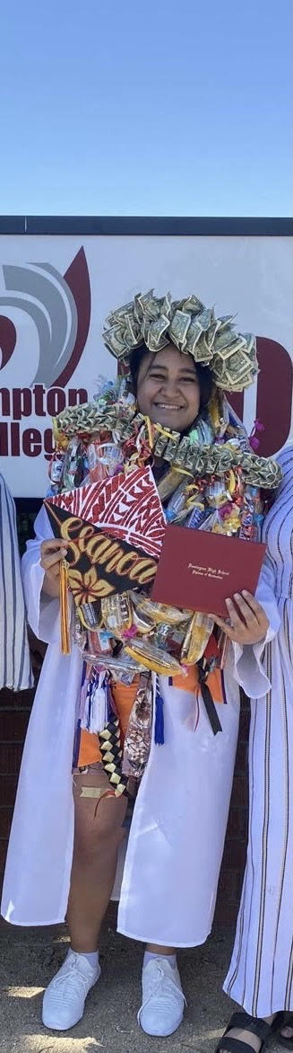
Christina Diaz Scholar Recipient
Si’i Seanoa
Dominguez High School & CSU Northridge
Notes:
David/Teresa: Si’i has been on the Honor Roll since the 9th Grade and does not shy away from classes that are challenging and unpopular. Her GPA is 4.08 and she took advanced classes. She served as a Leadership Officer and connects very well with her peers and promotes a positive school culture. She is a hard worker and determine to see everything she does to the fullest. Cynthia Washington, Counselor

Slide 24
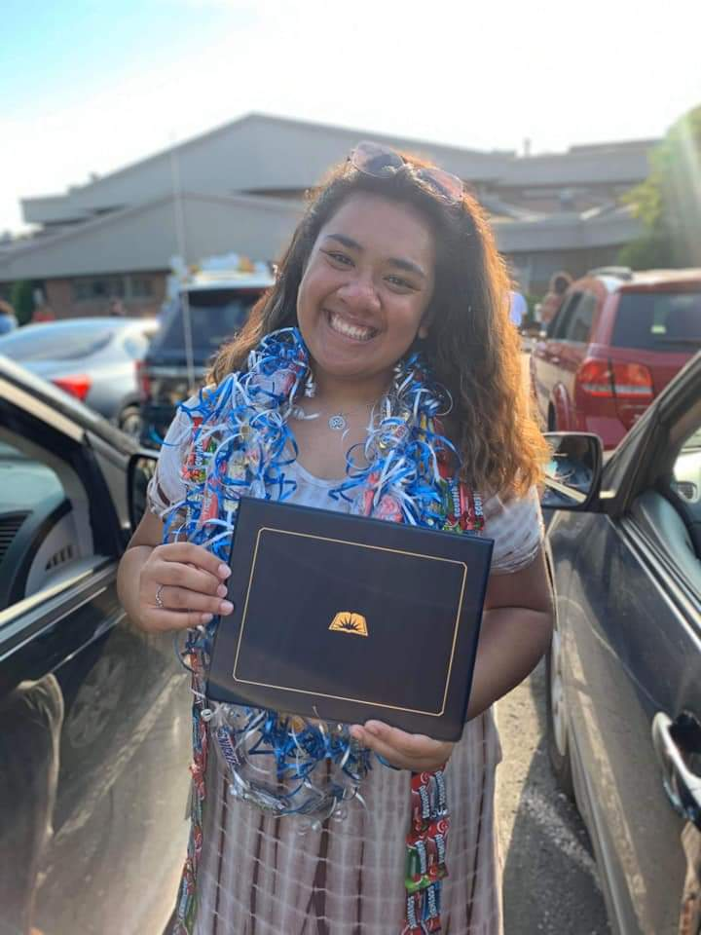
Christina Diaz Scholar Recipient
Olivia
Tali
William Chrisman High School & BYU Idaho Student
Place Photo Here
Notes:
David/Lupe: I am Lupe Moe, Retired Social Worker and Midwest Chapter Liaison: Olivia has a 3.75 GPA and is an outstanding student that has achieved her goals through being organized, determined, and compassionate. She plays multiple sports, is a member of the Blue and Gold Choir, and an active member in her church. Olivia is also very tenacious in achieving her dreams. She does not give up, is able to get over many hurdles and obstacles, and never stops without putting everything she has into it. She received the Young Woman’s Medallion at her church, on top of all her other commitments. Olivia ‘s compassion shows in sports as she is always the first one to check on others and to help them up. Olivia’s heart is always showing through her actions. Sarah Swartz, Counselor

Slide 25
Christina Diaz Scholar Recipient
Place Photo Here
Patso Tapusoa
Blue Springs High School
Notes:
David/Lupe: Patso moved in from out of state and immediately embraced the Blue Springs High Schools Wildcat Culture. He has been involved in multiple activities and serves as an office aid. He is a tremendous ambassador for Blue Springs. He treats staff and students with respect and brings a positive spirit to our campus. Wendell Fuimaono, Counselor

Slide 26
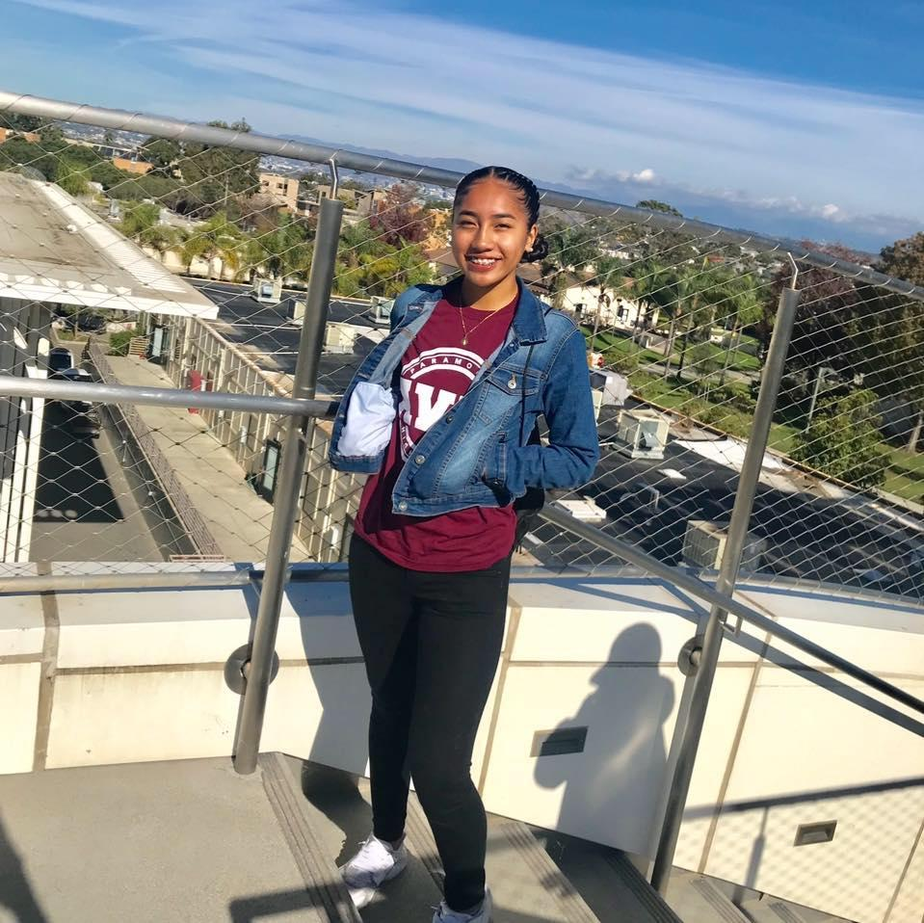
Christina Diaz Scholar Recipient
Place Photo Here
Telesia Tedtaotao
Paramount High School Student
Notes:
David/Hector: I am Hector Molina, NPIEN Past President and Business Owner, NT & Associates: Telesia is an exceptional young woman who, since her freshman year, has set her mind on pursuing higher education. She took the initiative of joining AVID and has taken honors and AP classes to prepare her for college.Telesia has an open heart; she is amiable and extends kindness to everyone whether in discussion groups in class or in her active participation in clubs. Many students work hard; however, not many are willing to help those around them. Telesia is one who believes in everyone succeeding and will continue this effort as a future teacher. Yvette Rodriguez, Teacher

Slide 27
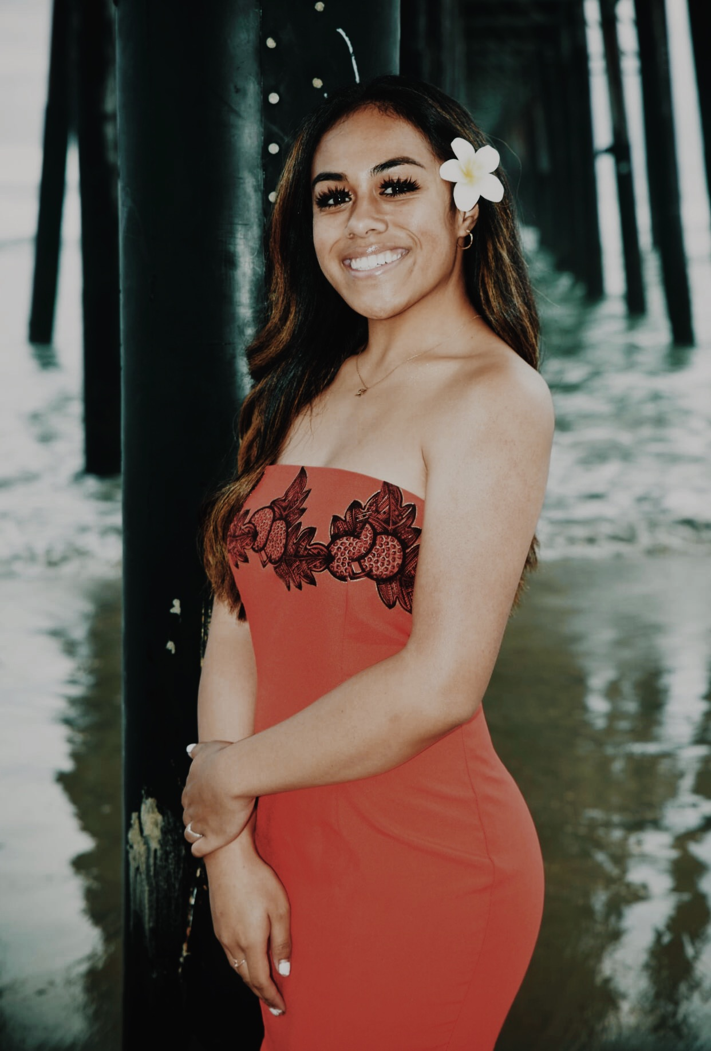
Christina Diaz Scholar Recipient
Place Photo Here
Sialataua Tuilefano
El Camino High School
Notes:
David/Hector: Sialataua participated in ASB, sports and clubs and maintaining a 2.76 GPA. She brings positivity and brightens the room with her smile. Now as a graduating senior, she has plans to pursue a degree in nursing in hopes of being able to use her kindness and compassion to help others.

Slide 28
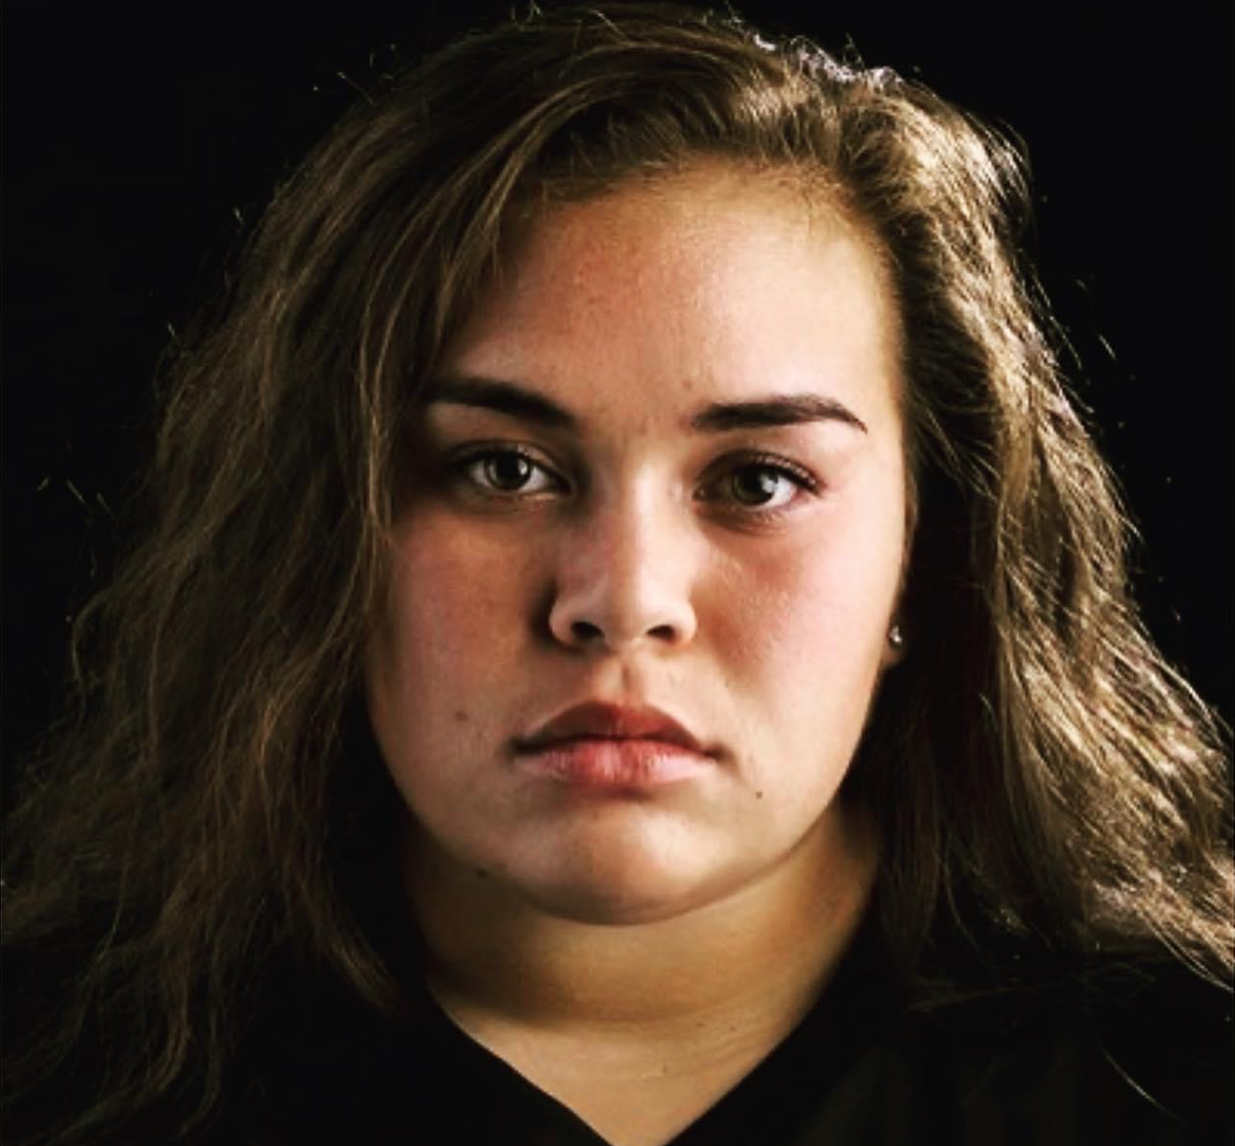
Christina Diaz Scholar Recipient
Kylie Tuimaualuga
Utah Valley University Student
Notes:
David/Tiloi: I am Tiloi Tuitama, Retired firefighter and football coach at Hueneme High School: Kylie is a Sophomore at Utah Valley University majoring in Art and Design, and is a two sport athlete in Soccer and Track and Field. She is an Honor Student has has a 3.85 GPA. She balances her time and is able to attend to her church assignments and her volunteer work.

Slide 29
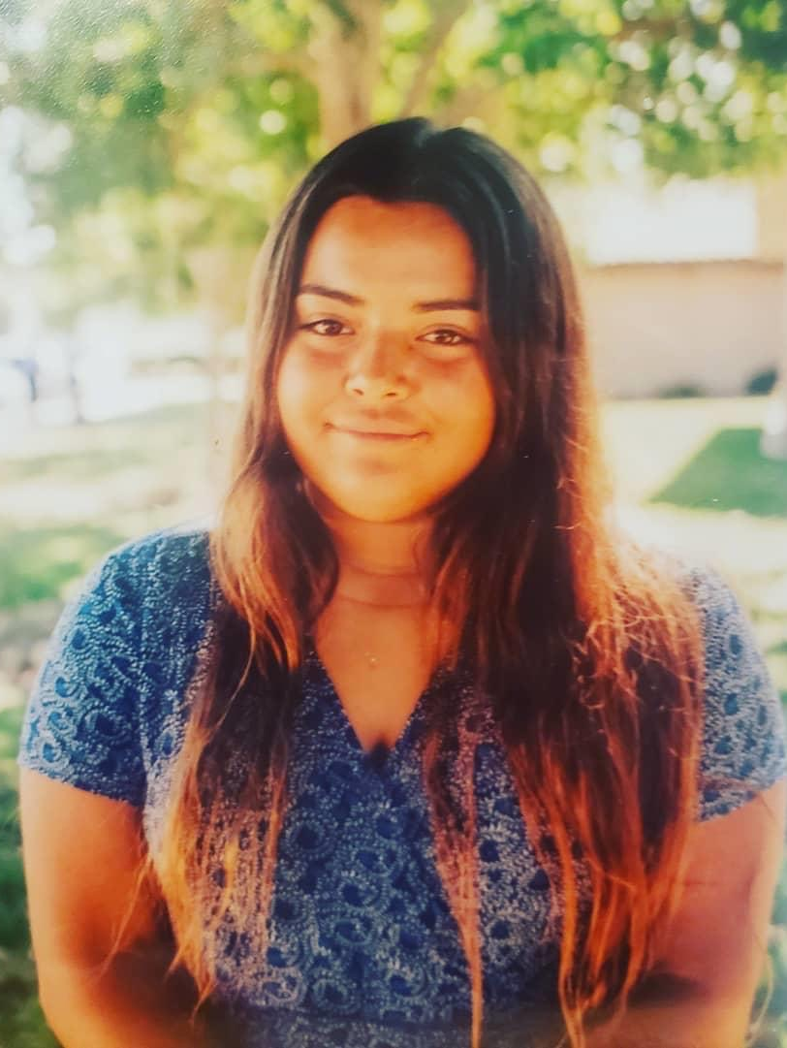
Christina Diaz Scholar Recipient
Place Photo Here
Laynie Tuimaualuga
Adolfo Camarillo High School Student
Notes:
David/Tiloi: Laynie is a 10th grader at Adolfo Camarillo High School in the Oxnard Unified School District. She is hard working, and also a talented singer and ukulele player. She plays water polo and softball and has performed on stage. She also volunteers in the community with her church.

Slide 30
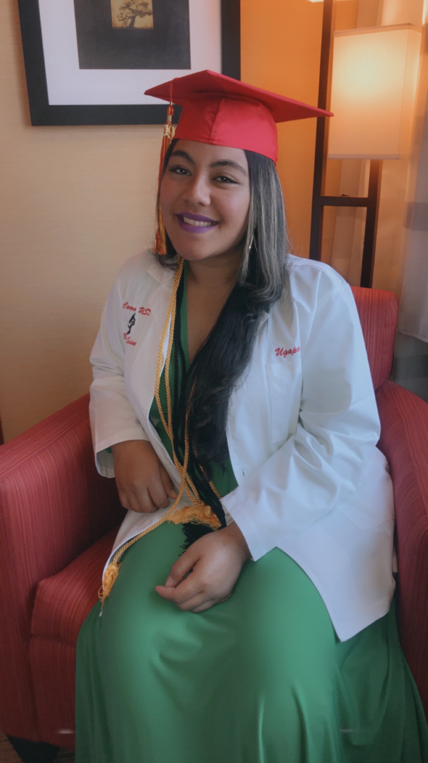
Christina Diaz Scholar Recipient
Place Photo Here
Diyari Ugapo
Dominguez High School & San Francisco State University
Notes:
David/Teresa: Diyari started at Dominguez High School as a 10th grader. She was very quiet, did not socialize much, but she was on the Honor Roll and in the Leadership Class. She reminds me of a rose as she has truly blossomed. She always helps at school events and helps students who are struggling academically. She is raised by a mother who volunteers at the school. She is a shining star. Counselor Cynthia Washington.

Slide 31
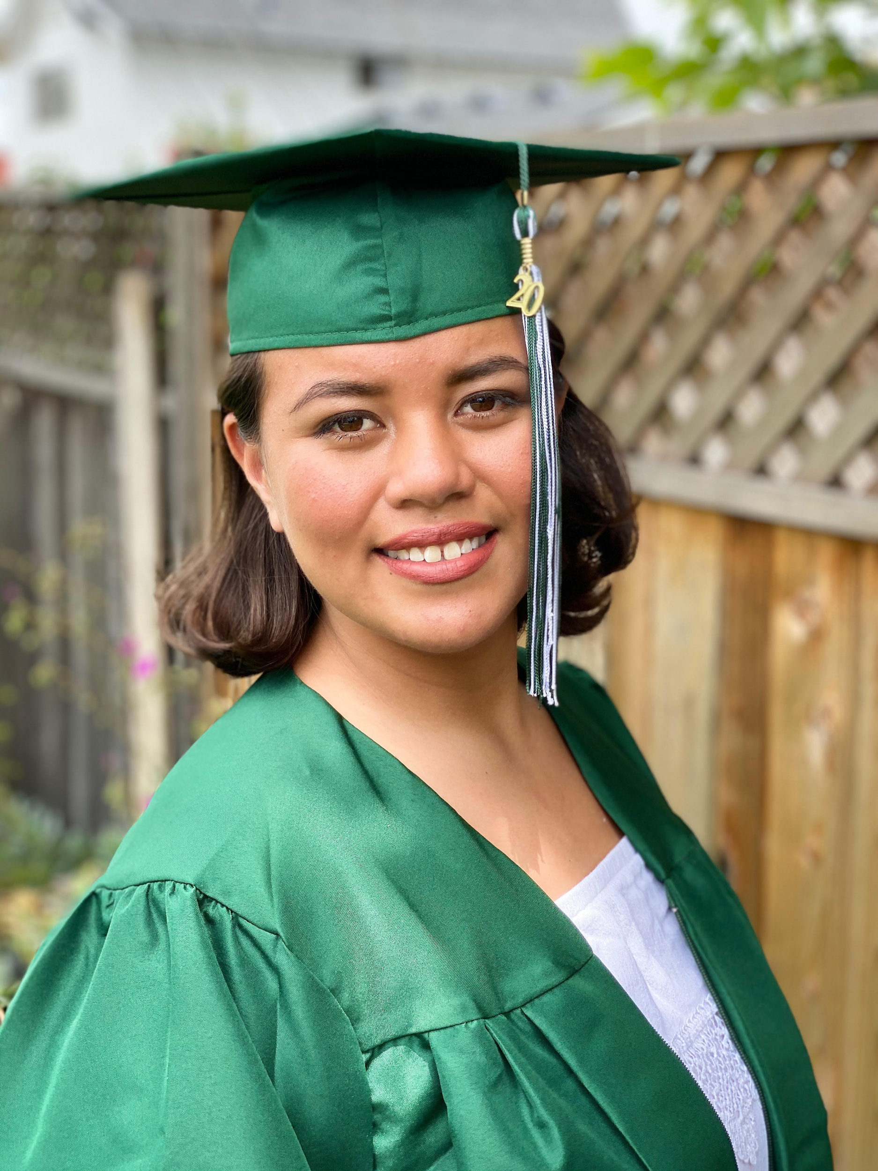
Christina Diaz Scholar Recipient
Ta’iuta Uiagalelei
Costa Mesa High School & Concordia University
Notes:
David/Will: Ta’iuta is strong, kind, caring, bright and hard working. She has blossomed into the young woman she is today and is proud of her heritage and culture. She aspire to be an elementary school teacher. She exudes patience and kindness, necessities for the teaching professions. She teachers children swim lessons, helos coach water polo, and teaches at her siblings elementary schools. As her teacher, I had her in a tough course, Calculus. She works harder, does not complain and has a growth mindset and a positive attitude. -Rachel Kloppenburg, Teacher
David: This concludes our Awards Ceremony and a virtual applause for all of our honorees

Slide 32
Conference Raffle
For those who registered by October 17th:
The prizes are one Ukulele, and gift cards from Harbor Freight, Olive Garden, and Subway.
Our winners are: Savannah Byrd, Cindy Chie, Terina Faleono, Jersey Lauti, Vai Matautia, Cynthia Notto, Nina Spears, Divine Taylor, Mia Valdez
Notes:
David: Read above, then announce winners

Slide 33
Conference Raffle - Part II:
Another raffle will take place in a week!
Another raffle will take place for those who visited the most colleges today. The College Fair will continue immediately at the conclusion of our ceremony. Go and visit our colleges now!
Notes:
David: Read the above

Slide 34
Thank You!
*Aloha*Adios*Alua*Aere Ra*Haere*Iokwe*Meichikung
*Moce*Na Na*Tofa
Notes:
David: See you on October 23, 2021, hopefully in-person. Thanks for your support! Visit the College Fair right now to qualify for the raffle

